Slide 1
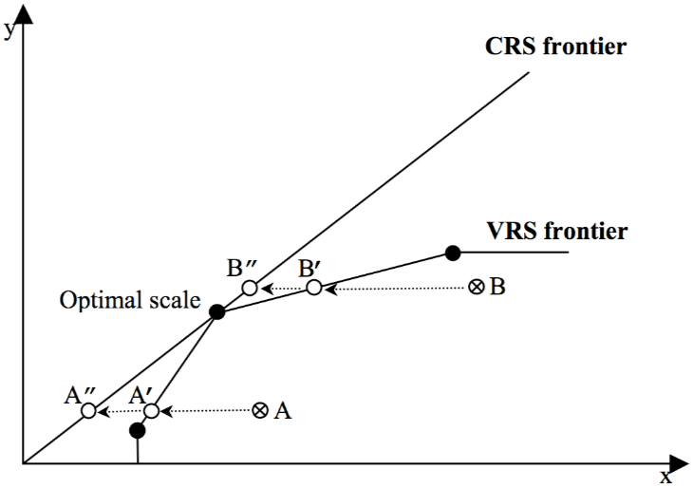

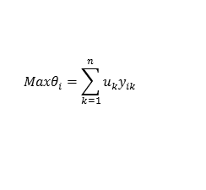



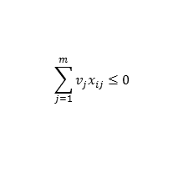

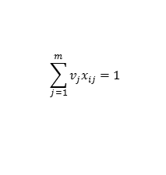

Efficiency Assessment of Transit Transfer Stations using Data Envelopment Analysis Model based on Smart Card Data
Eun Hak Lee
Hoyoung Lee
Seung-Young Kho
Dong-Kyu Kim*
Seoul National University, South Korea
17-06648
INTRODUCTION
METHODOLOGY
  Background
  The government of Seoul, South Korea, has been operating the integrated transit fare system based on smart card since 2004
  Within the integrated transit fare system, the user's transfer convenience at transit stations is a key element of assessing the attractiveness of public transit system
  Data Envelopment Analysis (DEA)
  Used for efficiency assessment of the service system
  Compared to the efficiency of the other DMU that perform similar activities method for determining the relative effectiveness
  Measuring the number of inputs and efficiency of DMU having a plurality of computing elements agreed by the weighted percentage of the weighted sum of inputs and output factors (Banker et al., 1984)
$${Maxθ}_{i}=\sum_{k=1}^{n}{u_{k}y_{ik}}$$
Subject to.
$$\sum_{j=1}^{m}{v_{j}x_{ij}≤0}$$
$$\sum_{j=1}^{m}{v_{j}x_{ij}=1}$$
  Research Objective
  Evaluating the “subway–bus” transfer efficiency of transfer stations using Data envelopment analysis (DEA) model
  How users’ dimension (transfer time), structural (subway stations’ gate, bus stops, bus lines, and connection etc.), operational (allocation time) factors affect efficiency
  Evaluating the efficiency of the transit station, considering the user's transfer behavior
  Suggest alternatives (or strategies) for efficiency planning and operating to identify the external factors that influence transfer efficiency using Tobit regression analysis
$$u_{k},v_{j}≥0$$
  External Factor Analysis
  Decisive factor analysis was conducted to confirm the decisive factors of efficiency from the DEA model by regression analysis
  Analysis of multi-collinearity by Pearson correlation analysis
  The effect of external factors on efficiency is analyzed by Tobit regression analysis
<Pearson Correlation Analysis>
<Tobit Regression Analysis>
$$ρ =\frac{E[(X−μ_{X})(Y−μ_{Y})]}{σ_{X}σ_{Y}}$$
$$\hat{θ_{i}}=βx_{1}+ε_{i}$$
Subject to.
$$θ_{i}=0 \text{if} \hat{θ}≤0$$
$$θ_{i}=1 \text{if} \hat{θ}≥1$$
$$θ_{i}=\hat{θ} \text{if} 0≤\hat{θ}≤1$$

Slide 2
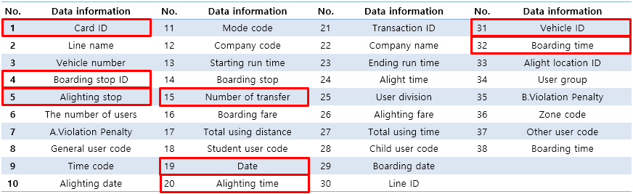
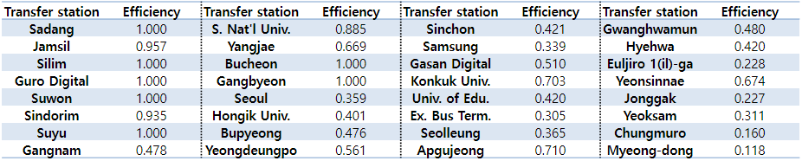
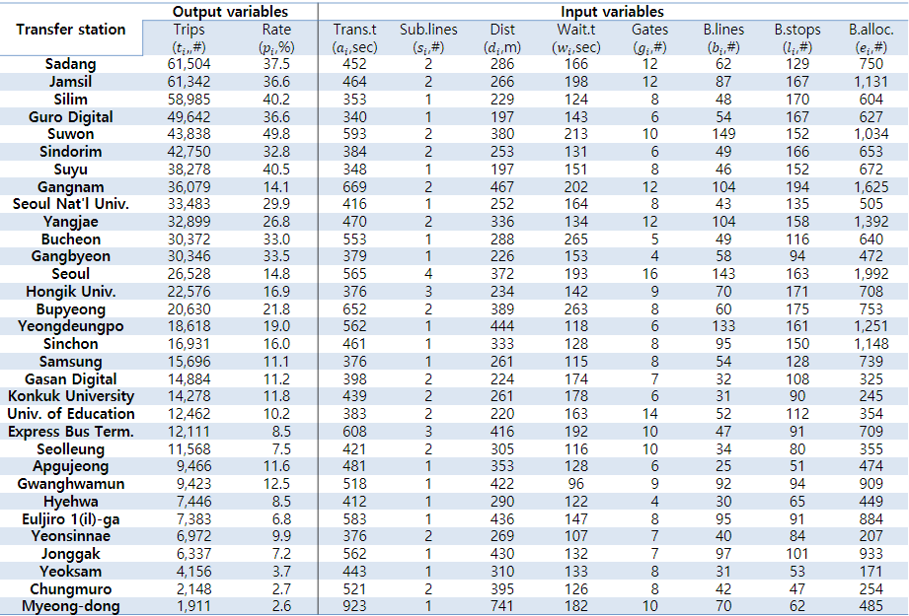
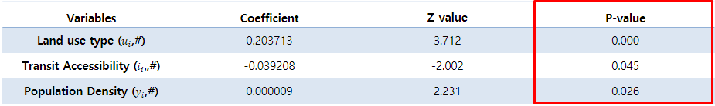
APPLICATION
  Application of DEA model
  The average efficiency score of 32 transfer stations was estimated to be 0.597 which means that their average input should be reduced by 40.3%
  The efficiency score was estimated higher at stations where the number of trips and rates are larger
  Even if the trips and ratio of transit stations are high, the efficiency was estimated to be low because of the over investment in facilities, such as Gangnam station
  Considering the scale of the transfer stations, larger station could disperse the transit facilities. The smaller transfer station could attract transfer trips
  Dataset
  The smart card data of Seoul consists of 15 million instances of individual transit information per day.
  Each of the bits of information is classified in 38 indices and provides more specific data. Smart card data could provide 99% of transit users’ trip information
  we extracted Card ID, boarding location ID, Alight location ID, number of Transfer, Date, alighting time, Vehicle ID, and Boarding time
  External Factor Analysis
  Regression analysis was performed with the Tobit model considering the correlation of external factor variables with Pearson correlation analysis
  Six socioeconomic indicators are used for external factors which are transit accessibility, land use type, population density, number of companies, number of households, and number of cars in station area less than 150m radius
  All independent variables were statistically significant at the 95% confidence level and the signs for all variables were suitable
  By the results, It is possible to increase the efficiency by dispersing public transportation facilities, and attracting users to transit in areas with high density or commercial districts
  Transfer efficiency was evaluated for 32 transfer stations
  32 transfer stations were regarded as the major stations based on the total number of transfer trips made
  The data information extracted from the smart card data was processed into two output variables and eight input variables for DEA model
CONCLUSION
  This paper evaluates the transit transfer efficiencies in 32 transit stations using DEA model based on smart card data in Seoul, Korea
  By the results of DEA model, larger station could disperse the transit facilities, considering the scale of the transfer stations and the smaller transfer station could attract transfer trips to improve efficiency
  With the socioeconomic indicators, transfer efficiency was explained in relation to the external environmental of transfer station
  This paper proposed to expand or reduce the transfer facility in station planning, considering the transfer efficiency of transfer station

